Slide 1
Search Algorithms: Object-Oriented Implementation (Part E)

Slide 2
Contents
Conventional vs. AI Algorithms
Local Search Algorithms
Genetic Algorithm
Implementing Hill-Climbing Algorithms
Defining ‘Problem’ Class
Adding Gradient Descent
Defining ‘HillClimbing’ Class
Adding More Algorithms and Classes
Adding Genetic Algorithm
Experiments

Slide 3
Adding More Algorithms and Classes
(TODO) Add 3 new Search Algorithms to the existing code:
  random-restart
  stochastic hill climbing
  simulated annealing
(TODO) Also, modify the class structure for expandability/extensibility
  To easily add diverse types of algorithm
Code implementation will be covered

Slide 4
Review (1/2)
From 09 Search Algorithm (A) previously...
  Search algorithms derived from Hill Climbing (= steepest ascent) :
    Stochastic hill climbing:
      Chooses at random from among the uphill moves with probability proportional to steepness
      Assigns probability to each candidate state/solution proportional to its steepness (gradient), and selects one based on this probability.
      The rest of the process is the same as First-Choice.
    Random-restart hill climbing:
      Conducts a series of hill-climbing searches from randomly generated initial states
      Repeats hill-climbing multiple times by varying the starting point (initial state), and selects the best solution among them
    First-choice (simple) hill climbing:
      Generates successors randomly until one is found that is better than the current state
      Randomly selects a candidate state and selects it if it is better than the current state (simple calculation).
New algorithm to be implemented
Already implemented

Slide 5
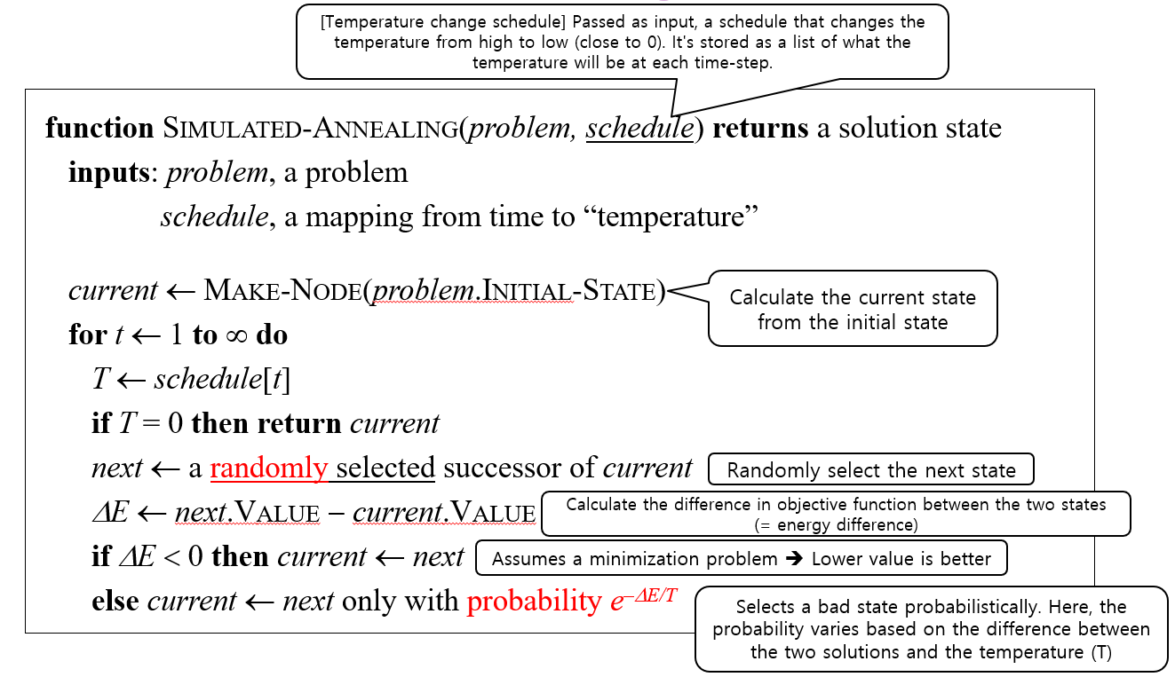
Review (2/2)
From 09 Search Algorithm (A) previously...
  Simulated Annealing Search Algorithm:
    Selects a bad solution with a random probability and, through this, can find a better solution.
    Note: Gradually reduce the probability of selecting a bad solution.
New algorithm to be implemented

Slide 6
Adding More Algorithms and Classes
(TODO) Add 3 new Search Algorithms to the existing code: stochastic hill climbing, random-restart, simulated annealing
  stochastic HC and random-restart are algorithms derived from Hill Climbing..
  In contrast, simulated annealing is a type of Meta-Heuristics algorithm.
    Summary of solution algorithm types:
      HillClimbing derived search algo. : 1) steepest ascent, 2) first-choice, 3) stochastic, 4) random-restart, 5) gradient descent
      MetaHeuristics derived search algo. : 1) simulated annealing, 2) GA (next topic)
  A more general class hierarchy is needed to encompass diverse types of search algorithms.
  Class Structure Refactoring: To do this, define a new class called Optimizer and modify the code so that the existing HillClimbing class and the newly defined MetaHeuristics class inherit from it.
Optimizer
HillClimbing
MetaHeuristics

Slide 7
Adding More Algorithms and Classes
(TODO) Add 3 new Search Algorithms to the existing code: stochastic hill climbing, random-restart, simulated annealing
  Since there are 5 algorithms of the HillClimbing type, 5 sub-classes can be created, and each can inherit the HillClimbing class to be implemented.
  However, we can implement only 4 sub-classes and design them so that the random-restart technique is executed by all classes that inherit HillClimbing through an implementation within the HillClimbing class.
    The techniques: steepest-ascent, first-choice, stochastic, gradient descent are all algorithms that define how to find the next solution and which one to select among them.
    random-restart is a technique that does not define how to find the next solution, but rather defines repeatedly performing hill climbing using a random initial solution and selecting the best solution among them. Therefore, it can be applied to all 4 remaining search algorithms.

Slide 8
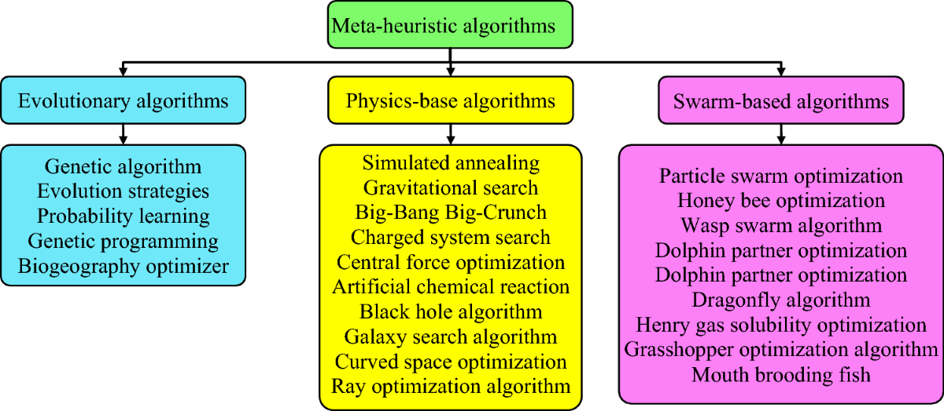
Adding More Algorithms and Classes
(TODO) Add 3 new Search Algorithms to the existing code: stochastic hill climbing, random-restart, simulated annealing
  MetaHeuristics will have two sub-classes: SimulatedAnnealing and GA (Note: GA is a technique we will learn about later).
    Note: Meta-Heuristics refers to an "algorithm that can be applied universally to any problem," not just limited to a specific problem.
    Note: A Heuristic algorithm refers to an algorithm designed to solve a given problem more quickly and efficiently, but its accuracy may be lower compared to algorithms based on exhaustive optimization.

Slide 9
Adding More Algorithms and Classes
optimizer.py : Modified configuration
Optimizer
HillClimbing
MetaHeuristics
randomRestart
SimulatedAnnealing
Implemented as function inside HillClimbing class (method)
SteepestAscent
GA
FirstChoice
Topic for later lectures
Stochastic
GradientDescent

Slide 10
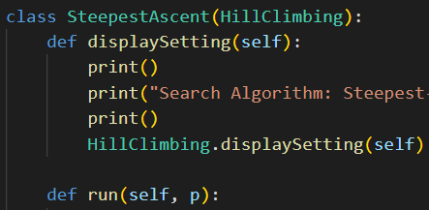
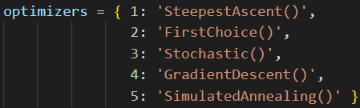
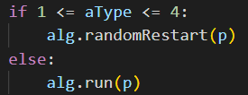
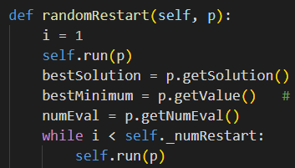
Adding More Algorithms and Classes
All Hill-Climbing algorithms are fundamentally executed through randomRestart, and they operate by repeating the execution of the selected algorithm for a specified number of times (e.g., repeating the execution a number of times influences the initial solution generated randomly) and selecting the best solution among them.
  Each hill climbing algorithm itself has its own run method, but if the randomRestart method is executed, inherited from the HillClimbing class, the randomRestart method operates by executing the run method defined in the algorithm selected by the user.
  Therefore, the randomRestart method, which is commonly used by a number of solution algorithms, is implemented in the HillClimbing class (which is the superclass of all hill-climbing algorithms) and is inherited by the sub-classes.
…
HillClimbing Class
In alg=SteepestAscent(), run method under SteepestAscent class is extecuted

Slide 11
Adding More Algorithms and Classes
When a hill-climbing algorithm is arbitrarily selected and executed:
  A class instance corresponding to the algorithm selected by the user is created and stored in alg.
  next, alg.randomRestart is executed, calling randomRestart.
  The randomRestart method works by repeatedly executing the self.run method of the selected hill-climbing algorithm (using a different random initial value each time).
Conversely, in the case of metaheuristic objects, they operate by creating an object of the selected class and immediately executing the run method.
Defined in the form of a Dictionary Value, which can be passed as an argument to the Python eval function to create a class instance (by calling the class constructor).

Slide 12

Adding More Algorithms and Classes
Modifying the User Interface as the number of algorithm types and associated parameters increases.
  Existing User Interface, the user inputs the following 3 pieces of information in the terminal:
    Problem type: Numeric / TSP
    Solution Algorithm: SA / FC / GradDesc
    Filename where the problem is defined: problem/xxx.txt
  Modified User Interface, the user inputs the following 1 piece of information in the terminal:
    The name of the text file where all parameters related to algorithm execution (= setup information) are defined.
    Contents to be included in the text file:
      Problem Type
      Solution Algorithm
      Filename where the problem is defined
      Parameter Values: delta, limitStuck, dx, numRestart, limitEval, numExp
      (File example: next slide...)

Slide 13
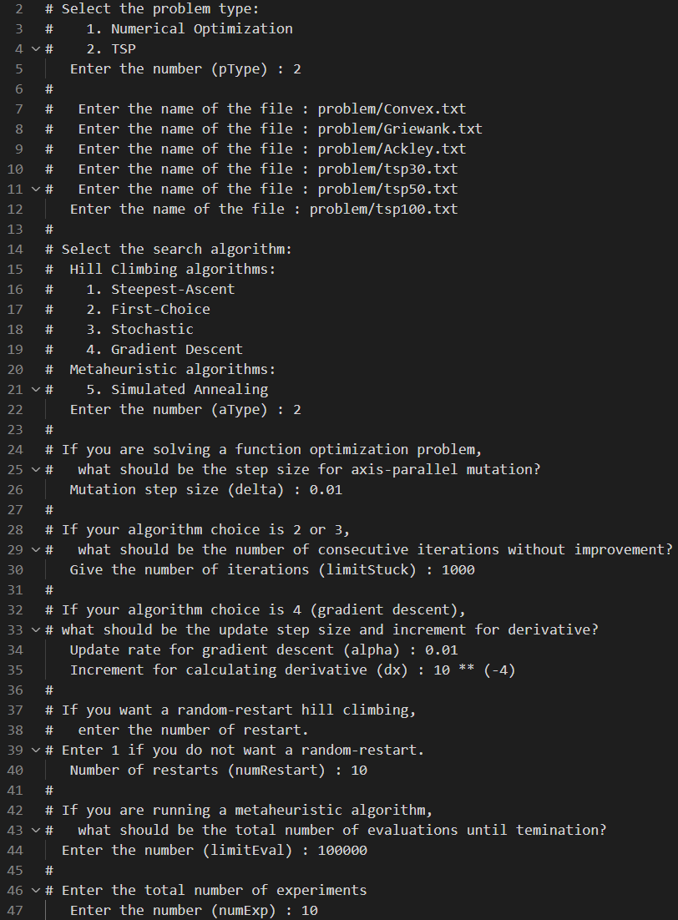
Adding More Algorithms and Classes
Modifying the User Interface as the number of algorithm types and associated parameters increases.
  Modified User Interface, the user inputs the following 1 piece of information in the terminal
    The name of the text file where all setup information are defined.
    Example text files (“#” line is a comment and will not be read):

Slide 14
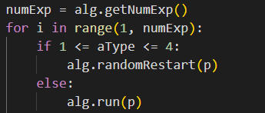
Adding More Algorithms and Classes
The following 4 variables were added to the Optimizer class or its sub-classes:
  (1) numExp:
    total number of experiments to be conducted.
    added to the Optimizer since it is commonly applied to all solution algorithms.
    In hill-climbing techniques it determines randomRestart method execution, in meta-heuristics it determines run method execution
      Hill-Climbing : Decides how many times the randomRestart method is called. The number of random restarts performed after randomRestart is called is determined by self.numRestart.
      Meta-Heuristics : Decides how many times the run method is called.
    In the main.py code...
Added
Details
Because the first experiment (i=0) is handled separately, the for loop executes only numExp - 1 times
The randomRestart function executes the algorithm repeatedly for self.numRestart times. Therefore, the Hill Climbing technique is executed a total of numExp * self.numRestart times.

Slide 15
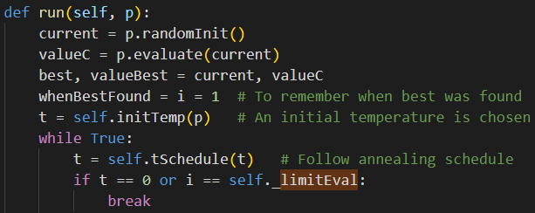
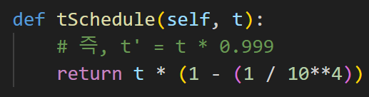
Adding More Algorithms and Classes
The following 4 variables were added to the Optimizer class or its sub-classes:
  (2) limitEval:
    maximum number of evaluations until termination for metaheuristic algorithms
    (Added to the MetaHeuristics class)
    run method in simulatedAnnealing class...
...
...
The temperature (t) is set to decrease gradually, but since it takes too long to reach 0 or may not reach 0 if set too aggressively, this variable (limitEval) is added to limit the number of algorithm executions when the temperature is very close to 0.
Temperature scheduling setup

Slide 16

Adding More Algorithms and Classes
The following 4 variables were added to the Optimizer class or its sub-classes:
  (3) whenBestFound:
    the number of iterations taken until the best solution has first been found
    (Added to the MetaHeuristics class)
    It stores how many total iterations were executed until the best solution was found.
    run method in simulatedAnnealing class...
...
...

Slide 17

Adding More Algorithms and Classes
The following 4 variables were added to the Optimizer class or its sub-classes:
  (4) numRestart:
    number of random restarts for the random-restart algorithm (Added to HillClimbing class)
    This variable determines how many times the random restart will be repeated when randomRestart is called.
    randomRestart method in HillClimbing class...
Calls the run method of the class for the solution algorithm selected by the user.

Slide 18
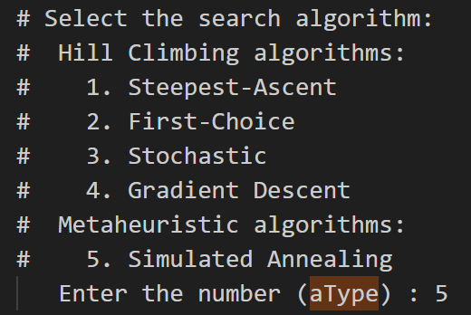
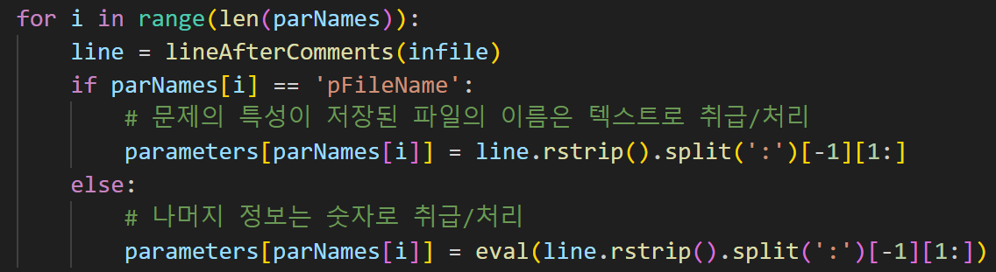
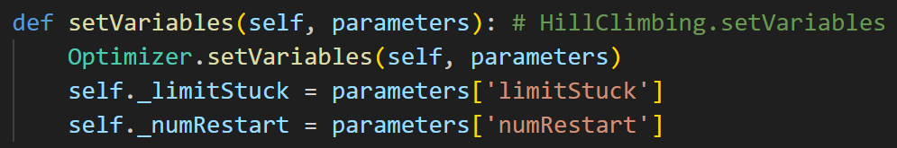
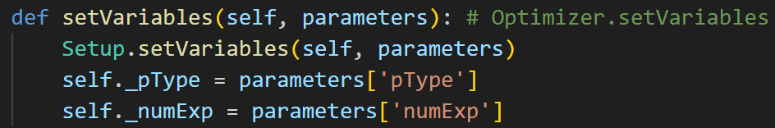
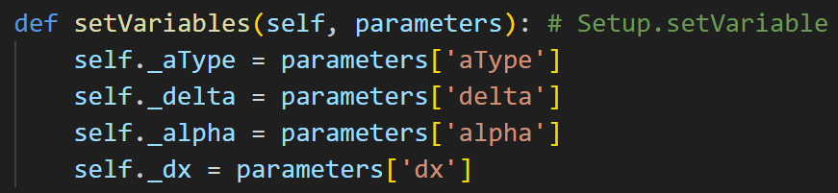
Adding More Algorithms and Classes
The aType member variable is added to the Setup class.
  Since this variable is used by both the superclass Problem defined in problem.py and the superclass Optimizer defined in optimizer.py, the aType variable is added to the Setup class, which is inherited by both.
    It is referenced by the revised report method of Problem
    It is also referenced by displaySetting of Optimizer
main.py

Slide 19
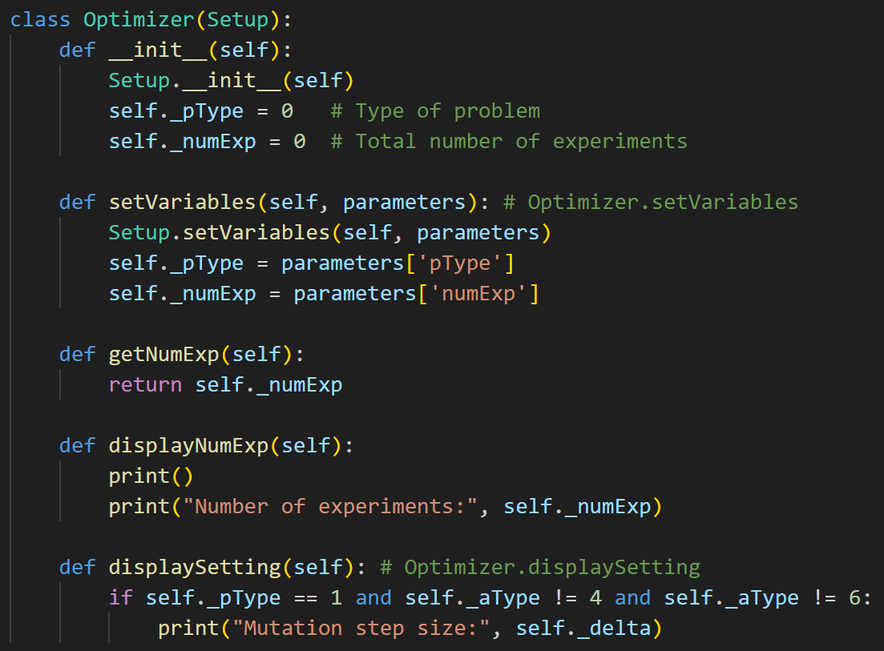
Adding More Algorithms and Classes
The code was modified to reference the pType variable in the displaySetting method of the Optimizer class. Due to this change, the pType variable was moved from the HillClimbing class to the Optimizer class.

Slide 20
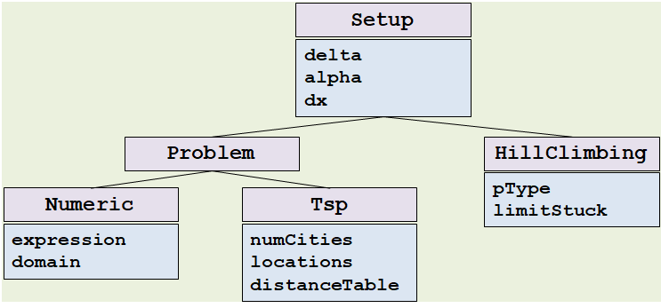
Adding More Algorithms and Classes
The original class structure
the location of the aType variable and the newly added 4 variables (numExp, numRestart, limitEval, whenBestFound) within the class hierarchy.
Setup
aType
delta
alpha
dx
Problem
Optimizer
solution
value
numEval
pType
numExp
HillClimbing
MetaHeuristics
Numeric
Tsp
limitStuck
numRestart
limitEval
whenBestFound
expression
domain
numCities
locations
distanceTable
The 4 solution algorithms (SA, FC, Stochastic, GD)
Simulated Annealing and GA

Slide 21
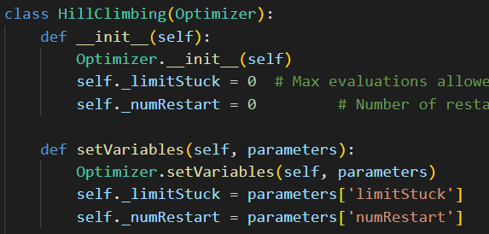
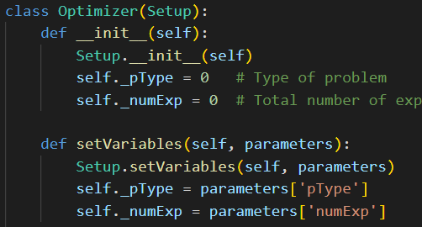
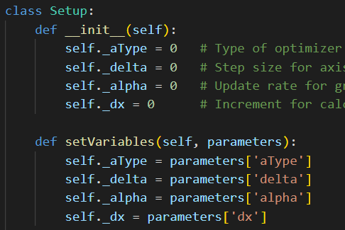
Adding More Algorithms and Classes
In most cases, you create and use an instance of the class located at the lowest level of the class inheritance relationship.
  Problem Type: Numeric / Tsp
  Solution Algorithms: HC(SA, FC, Stochastic, GC), MetaHeuristics(SimulAnn, GA)
This way, you can use the member variables and methods defined in the superclass.
  Specifically, when inheriting and using methods with the same name from multiple superclasses, you must explicitly specify which class's method to use.
    For example, the HillClimbing class's setVariables method calls the Optimizer class's setVariables method.
    Example call: Optimizer.setVariables(self, parameters)

Slide 22
Adding More Algorithms and Classes
In most cases, you create and use an instance of the class located at the lowest level of the class inheritance relationship.
  Problem Type: Numeric / Tsp
  Solution Algorithms: HC(SA, FC, Stochastic, GC), MetaHeuristics(SimulAnn, GA)
This way, you can use the member variables and methods defined in the superclass.
  When creating a class instance, the related initializer methods (__init__) must be called so that all variables, up to the topmost superclass, are appropriately initialized or set.

Slide 23
Source Code Modification Summary
Code | Change details
setup.py | The aType variable was added, and the setVariables method was added.
problem.py | There are no major changes compared to the existing v3 code, but there are some minor changes, such as adding member variables to store algorithm execution results, and changes to functions that output execution results.
main.py | The way information like problem type/algorithm type is passed has changed. There is a major change in the user interface, such as reading variables (e.g., dx) that were previously fixed as default values from a text file, leading to overall code modification.
optimizer.py | A new superclass called Optimizer was added. Due to the addition of 3 solution algorithms (random, stochastic, simulated annealing), new classes were defined: Stochastic, MetaHeuristics, SimulatedAnnealing.

Slide 24
Source Code Structure
Key methods by source code file (focusing on newly added methods)
main.py
Method | Description
readPlanAndCreate, readValidPlan, readPlan | Obtains information related to the problem and algorithm execution from the file (at this time, lines treated as comments in the file are skipped). Creates separate class instances corresponding to the problem and the algorithm.
conductExperiment | Executes the algorithm to find a solution for the given problem.

Slide 25
Source Code Structure
Key methods by source code file (focusing on newly added methods)
optimizer.py
Method | Description
HillClimbing.randomRestart | Executes the run method for numRestart times and saves the best solution among them (storeResult) Note: The run method starts by generating a random initial solution and repeats until a better solution no longer emerges.
Stochastic.run | Similar to steepest ascent, it generates neighbor solutions randomly, then probabilistically selects the best solution among them (stochasticBest).
Stochastic.stochasticBest | Probabilistically selects one from among the neighbor solutions (at this time, it uses the results of evaluating each solution).

Slide 26
Source Code Structure
Key methods by source code file (focusing on newly added methods)
optimizer.py
Method | Description
SimulatedAnnealing.run | Generates one random neighbor solution (similar to FirstChoice). Selects the neighbor solution probabilistically.
SimulatedAnnealing.initTemp | Sets the initial parameters so that the probability of selecting a bad neighbor solution is 0.5 (Initial temperature setting).
SimulatedAnnealing.tSchedule | Gradually decreases the probability of selecting a bad neighbor solution as the iteration repeats. That is, it is gradually decreased by the temperature value (temperature is high -> high probability of selecting a bad solution).

